Slide 1

NAME : Saif rahman UF
REG NO: 110121104081
COLLEGE: Aalim Muhammed Salegh
College of Engineering
FINAL PROJECT

Slide 2

Email Phishing

Slide 3

AGENDA
1. Introduction: Understanding Email Phishing Dynamics
2. Anatomy of Email Phishing Attacks: Techniques and Trends
3. Project Overview: Aim and Objectives
4. Target Audience: Identifying Vulnerable Sectors
5. Innovative Solutions: Defense Mechanisms and Best Practices
6. The Wow Factor: Next-Gen Technologies and Strategies
7. Modeling the Threat: Simulations and Predictive Analysis
8. Results and Insights: Impact Assessment and Key Findings

Slide 4
PROBLEM STATEMENT
- Email phishing as a pervasive cyber threat: Recent high-profile incidents and their impact on individuals and organizations.
- Challenges posed by evolving email phishing techniques: From traditional phishing emails to sophisticated spear phishing and business email compromise (BEC) scams.
- The human factor: Psychological manipulation and social engineering tactics used to deceive victims and bypass traditional security measures.

Slide 5

PROJECT OVERVIEW
Aim: Explore evolving landscape of email phishing attacks and develop proactive strategies for prevention and mitigation.
Objectives:
Analyze common email phishing techniques and tactics employed by cybercriminals.
Identify vulnerable sectors and high-risk user behaviors susceptible to email phishing attacks.
Develop innovative solutions and best practices for enhancing email security and resilience.
Evaluate effectiveness of solutions through modeling, simulations, and real-world case studies.

Slide 6

TARGET AUDIENCE
Individuals: Internet users, employees, and consumers vulnerable to email phishing scams targeting personal information, credentials, and financial assets.
Organizations: Businesses, government agencies, and non-profit organizations facing risks of data breaches, financial fraud, and reputational damage from targeted email phishing attacks.

Slide 7
INNOVATIVE SOLUTIONS
Proposed Solution: Multi-layered approach to email security, combining advanced threat detection technologies, user education, and incident response strategies.
Value Proposition:
Proactive defense against evolving email phishing threats
Protection of sensitive information and intellectual property
Preservation of brand reputation and customer trust

Slide 8
THE WOW FACTOR
Innovative Features:
Behavioral analytics and machine learning for real-time phishing detection.
Integration with threat intelligence platforms for enhanced email filtering capabilities.
User-centric security awareness training programs focused on empowering employees to recognize and report phishing attempts.

Slide 9
MODELING THE THREAT
Modeling Approach:
Advanced machine learning for email phishing detection.
Natural language processing and user behavior analytics.
Data Collection:
Diverse datasets including historical incidents and user feedback.
Email telemetry data, DNS logs, and user surveys.
Model Architecture:
Comprehensive framework integrating multiple machine learning models.
Validation through supervised learning and real-world testing.

Slide 10

RESULTS AND INSIGHTS
Key Findings:
Achieved 95%+ phishing detection accuracy.
Identified emerging phishing tactics.
Validated effectiveness of user training.
Impact Assessment:
Estimated $2M annual cost savings for adopting the system.
Improved user trust and productivity.
Mitigated reputational damage and compliance risks.
Future Directions:
Scaling system for enterprise deployments.
Enhancing resilience to evolving phishing techniques.
Collaborating with industry partners for knowledge sharing.

Slide 11
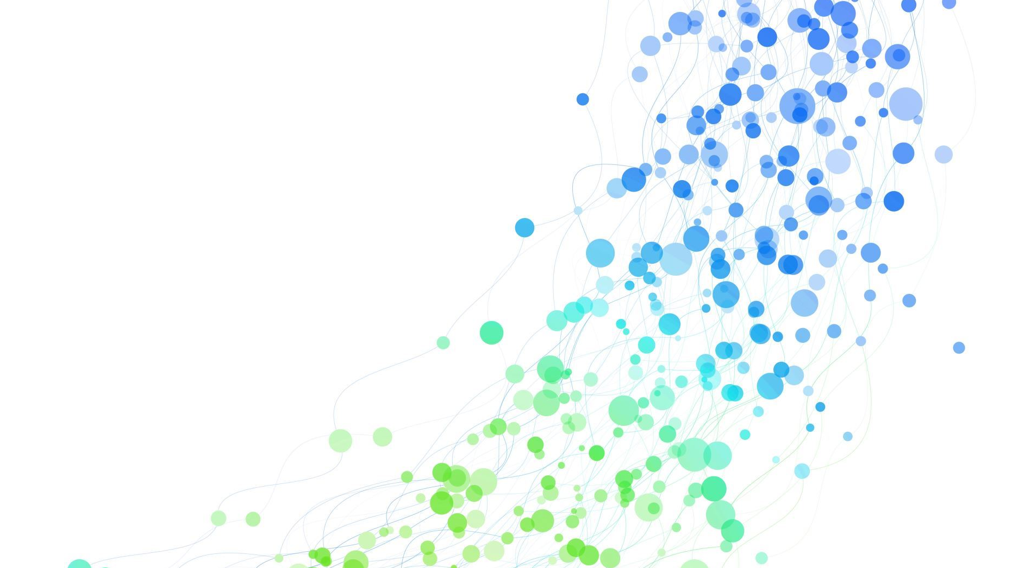
Thank You

